Slide 1
this, static & final

Slide 2
this Keyword
Sometimes a method will need to refer to the object that invoked it.
To allow this, Java defines the this keyword.
this can be used inside any method to refer to the current (invoking) object.
this is always a reference to the object on which the method was invoked.
You can use this anywhere a reference to an object of the current class’ type is permitted.
In the body of the method, the this reference can be used like any other object reference to access members of the object.

Slide 3
this Keyword
As you know, it is illegal in Java to declare two local variables with the same name inside the same or enclosing scopes.
Interestingly, you can have local variables, including formal parameters to methods, which overlap with the names of the class’ instance variables.
However, when a local variable has the same name as an instance variable, the local variable hides the instance variable.

Slide 4
this Keyword
Example:
class A {
int i=10;
void show()
{
int i=100;
System.out.println("Local variable i: "+i);
System.out.println("Instance variable i: "+i);
}
public static void main(String args []) {
A obj = new A();
obj.show();
}
}

Slide 5
this Keyword
Example:
class A {
int i=10;
void show()
{
int i=100;
System.out.println("Local variable i: "+i);
System.out.println("Instance variable i: "+this.i);
}
public static void main(String args []) {
A obj = new A();
obj.show();
}
}

Slide 6
this Keyword
Example:
class A {
int i=10;
void show()
{
int i=100;
System.out.println("Local variable i: "+i);
System.out.println("Instance variable i: "+this.i);
}
public static void main(String args []) {
A obj = new A();
obj.show();
}
}
Output:
Local variable i: 100
Instance variable i: 10

Slide 7
this Keyword
In particular, the this reference can be used explicitly to invoke other methods in the class.

Slide 8
this Keyword
Example:
class A {
void show()
{
System.out.println("In show() ");
test();
}
void test()
{
System.out.println("In test() ");
}
public static void main(String args []) {
A obj = new A();
obj.show();
}
}

Slide 9
this Keyword
Example:
class A {
void show()
{
System.out.println("In show() ");
test();
}
void test()
{
System.out.println("In test() ");
}
public static void main(String args []) {
A obj = new A();
obj.show();
}
}
Output:
In show()
In test()

Slide 10
this Keyword
Example:
class A {
void show()
{
System.out.println("In show() ");
this.test();
}
void test()
{
System.out.println("In test() ");
}
public static void main(String args []) {
A obj = new A();
obj.show();
}
}

Slide 11
this Keyword
Example:
class A {
void show()
{
System.out.println("In show() ");
this.test();
}
void test()
{
System.out.println("In test() ");
}
public static void main(String args []) {
A obj = new A();
obj.show();
}
}
Output:
In show()
In test()

Slide 12
this Keyword
In particular, the this reference can be used explicitly to invoke other methods in the class.
If, for some reason, a method needs to pass the current object to another method, it can do so using the this reference.
Another use of this keyword to call the other constructor of the same class.
Note that the this reference cannot be used in a static context, as static code is not executed in the context of any object.

Slide 13
Understanding static
There will be times when you will want to define a class member that will be used independently of any object of that class.
When a member is declared static, it can be accessed before any objects of its class are created, and without reference to any object.
You can declare both methods and variables to be static.
When objects of its class are declared, no copy of a static variable is made. Instead, all instances of the class share the same static variable.
A static variable belongs to the class, and not to any object of the class.
A static variable is initialized when the class is loaded at runtime.
Similarly, a class can have static methods that belong to the class, and not to any specific objects of the class.

Slide 14
Understanding static
Static members can also be accessed via object references, but this is considered bad style.
Static members in a class can be accessed both by the class name and via object references, but instance members can only be accessed by object references.
Java supports static block that gets executed exactly once, when the class is first loaded.
Methods declared as static have several restrictions:
They can only directly call other static methods.
They can only directly access static data.
They cannot refer to this or super in any way.

Slide 15
Understanding static
Example:
class A {
static int a = 5;
static int b;
static void show(int x) {
System.out.println("x = " + x);
System.out.println("a = " + a);
System.out.println("b = " + b);
}
static {
System.out.println("Static block initialized.");
b = a * 5;
}
public static void main(String args []) {
show(10);
}
}

Slide 16
Understanding static
Example:
class A {
static int a = 5;
static int b;
static void show(int x) {
System.out.println("x = " + x);
System.out.println("a = " + a);
System.out.println("b = " + b);
}
static {
System.out.println("Static block initialized.");
b = a * 4;
}
public static void main(String args []) {
show(10);
}
}
Output:
Static block initialized.
x = 10
a = 5
b = 20

Slide 17
Understanding static
As soon as class A is loaded, all of the static statements are run.
First, a is set to 5, then the static block executes, which prints a message and then initializes b to a*4 or 20.
Then main( ) is called, which calls show( ), passing 10 to x.
The three println( ) statements refer to the two static variables a and b, as well as to the local variable x.

Slide 18
Understanding static
Outside of the class in which they are defined, static methods and variables can be used independently of any object.
To do so, you need only specify the name of their class followed by the dot operator.
classname.method( )
Here, classname is the name of the class in which the static method is declared.
A static variable can be accessed in the same way—by use of the dot operator on the name of the class.

Slide 19
Understanding static
Example:
class A {
static int a = 5;
static int b=10;
static void show() {
System.out.println("a = " + a);
}
}
class B
{
public static void main(String args []) {
A.show();
System.out.println("b = " + A.b);
}
}

Slide 20
Understanding static
Example:
class A {
static int a = 5;
static int b=10;
static void show() {
System.out.println("a = " + a);
}
}
class B
{
public static void main(String args []) {
A.show();
System.out.println("b = " + A.b);
}
}
Output:
a = 5
b = 10

Slide 21
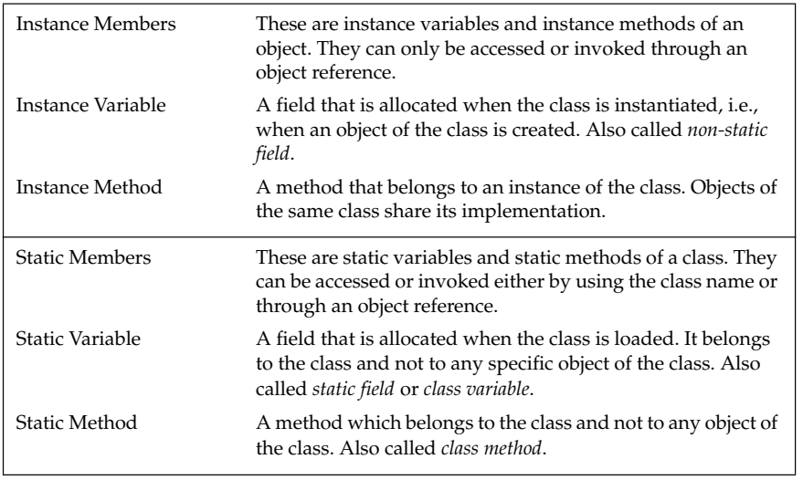
Understanding static

Slide 22
Understanding final
Members of the class can be declared as final.
Instance and static variables can be declared final.
Note that the keyword final can also be applied to local variables, including method parameters.
In addition to fields, both method parameters and local variables can be declared final.
Final static variables are commonly used to define constants.
Declaring a parameter final prevents it from being changed within the method.
Declaring a local variable final prevents it from being assigned a value more than once.
There are two ways to initialize final variables.
First, you can give it a value when it is declared.
Second, you can assign it a value within a constructor.

Slide 23
Understanding final
A final variable of a reference type cannot change its reference value once it has been initialized.
This effectively means that a final reference will always refer to the same object.
A final method in a class is complete and cannot be overridden in any subclass.
Final variables ensure that values cannot be changed and final methods ensure that behavior cannot be changed.
The compiler may be able to perform code optimizations for final members, because certain assumptions can be made about such members.

Slide 24
Understanding final
Sometimes you will want to prevent a class from being inherited.
To do this, precede the class declaration with final.
Declaring a class as final implicitly declares all of its methods as final, too.
As you might expect, it is illegal to declare a class as both abstract and final since an abstract class is incomplete by itself and relies upon its subclasses to provide complete implementations.

